Slide 1
Data treatment and measurement statistics for time-of-flight neutron scattering experiments
Andrei Savici
Neutron Data Analysis and Visualization Division

Slide 2
Outline
Motivation
Classical single crystal diffraction data reduction
Revisit the theory for neutron diffraction
Covering reciprocal space – how to improve speed and memory usage for algorithms
Extending the formalism for neutron spectroscopy
More on measurement statistics

Slide 3
Motivation
What we measure is important, but we can make sense of it only if we know HOW we measure it
By knowing HOW we measure things we can:
Calculate the statistical significance of the measurements
Design algorithms and procedures to reduce, visualize, and analyze neutron scattering data

Slide 4
Motivation
Diffuse elastic scattering
Neutrons ideal to look at lighter ions
Limited coverage – need to use multiple orientations
BUT: no procedure to look at TOF diffuse scattering neutron diffraction data
Diffuse X-ray scattering from β-NaLaF₄
A. Aebischer et al., Angew. Chem. Int. Ed. 45, 2802 –2806 (2006)

Slide 5
Motivation
Inelastic neutron scattering can be used to study magnetic scattering
We want to look at large volumes in the reciprocal space, so we use multiple sample orientations
Current data reduction processes are slow, and use a lot of memory
Magnetic scattering in YFeO₃
S. E. Hahn et al., Phys. Rev. B 89 (2014) 014420

Slide 6
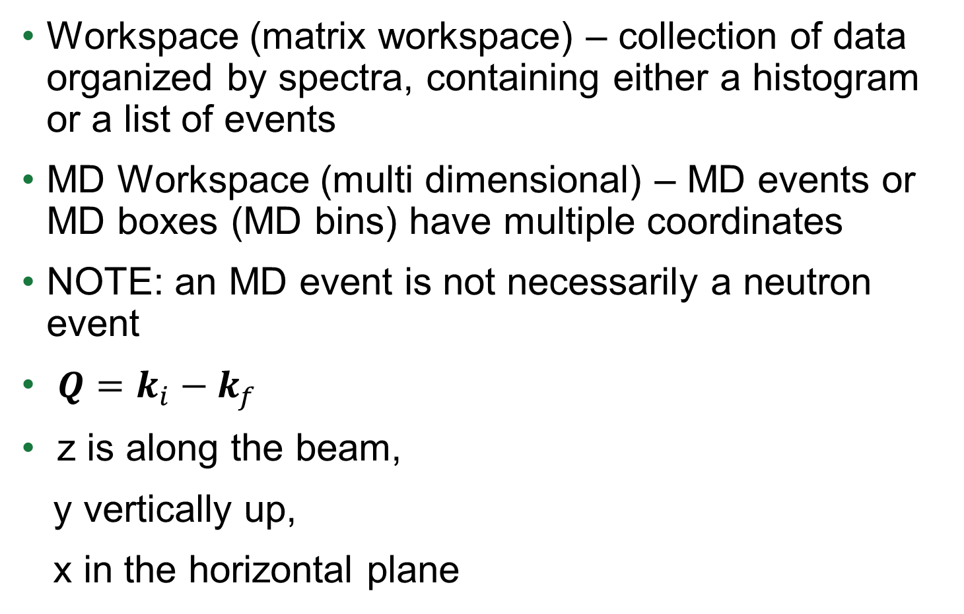
Definitions
Workspace (matrix workspace) – collection of data organized by spectra, containing either a histogram or a list of events
MD Workspace (multi dimensional) – MD events or MD boxes (MD bins) have multiple coordinates
NOTE: an MD event is not necessarily a neutron event
$Q=k_{i}−k_{f}$
z is along the beam,
y vertically up,
x in the horizontal plane

Slide 7
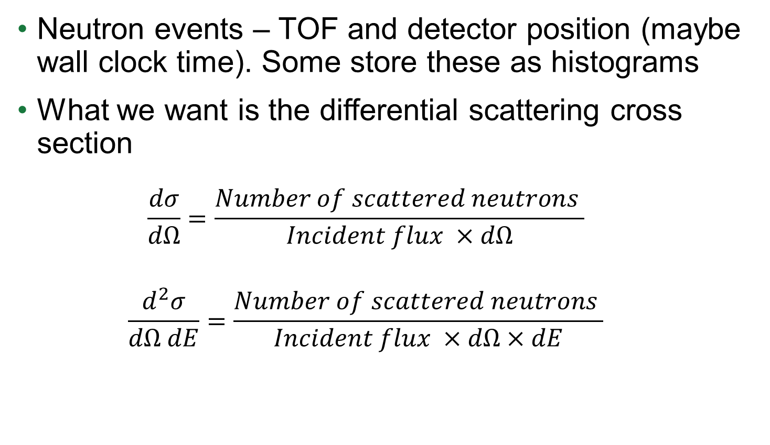
What do we measure?
Neutron events – TOF and detector position (maybe wall clock time). Some store these as histograms
What we want is the differential scattering cross section
$$\frac{dσ}{dΩ}=\frac{Number of scattered neutrons }{Incident flux ×dΩ}$$
$$\frac{d^{2}σ}{dΩ dE}=\frac{Number of scattered neutrons }{Incident flux ×dΩ×dE}$$

Slide 8
Single crystal diffraction data reduction
ConvertToMD – with Lorentz correction
FindPeaksMD
FindUB
IndexPeaks
IntegratePeaksMD
SavePeaks – but doing Anvred and spectrum corrections

Slide 9
What is Lorentz/spectrum correction?

Slide 10
Diffuse scattering – raw data

Slide 11
Adding normalized data

Slide 12
Lessons learned from TAS
When adding data together we add monitors together and plot summed data divided by monitor data
This accounts for different integrated flux on the sample
The important quantity is not the neutron count, but the normalized neutron count
Order of operations is important

Slide 13
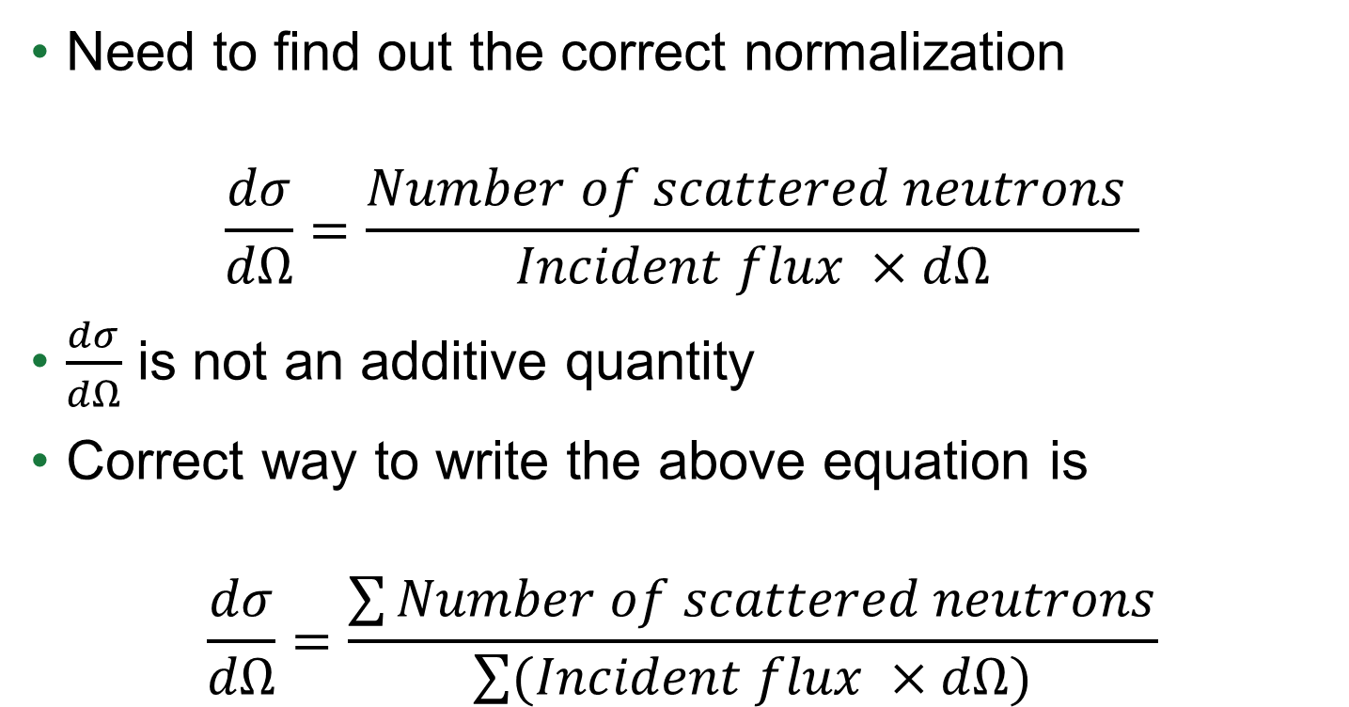
Neutron diffraction - the correct way
Need to find out the correct normalization
$$\frac{dσ}{dΩ}=\frac{Number of scattered neutrons }{Incident flux ×dΩ}$$
$\frac{dσ}{dΩ}$ is not an additive quantity
Correct way to write the above equation is
$$\frac{dσ}{dΩ}=\frac{\sum{Number of scattered neutrons}}{\sum{(Incident flux ×dΩ})}$$

Slide 14
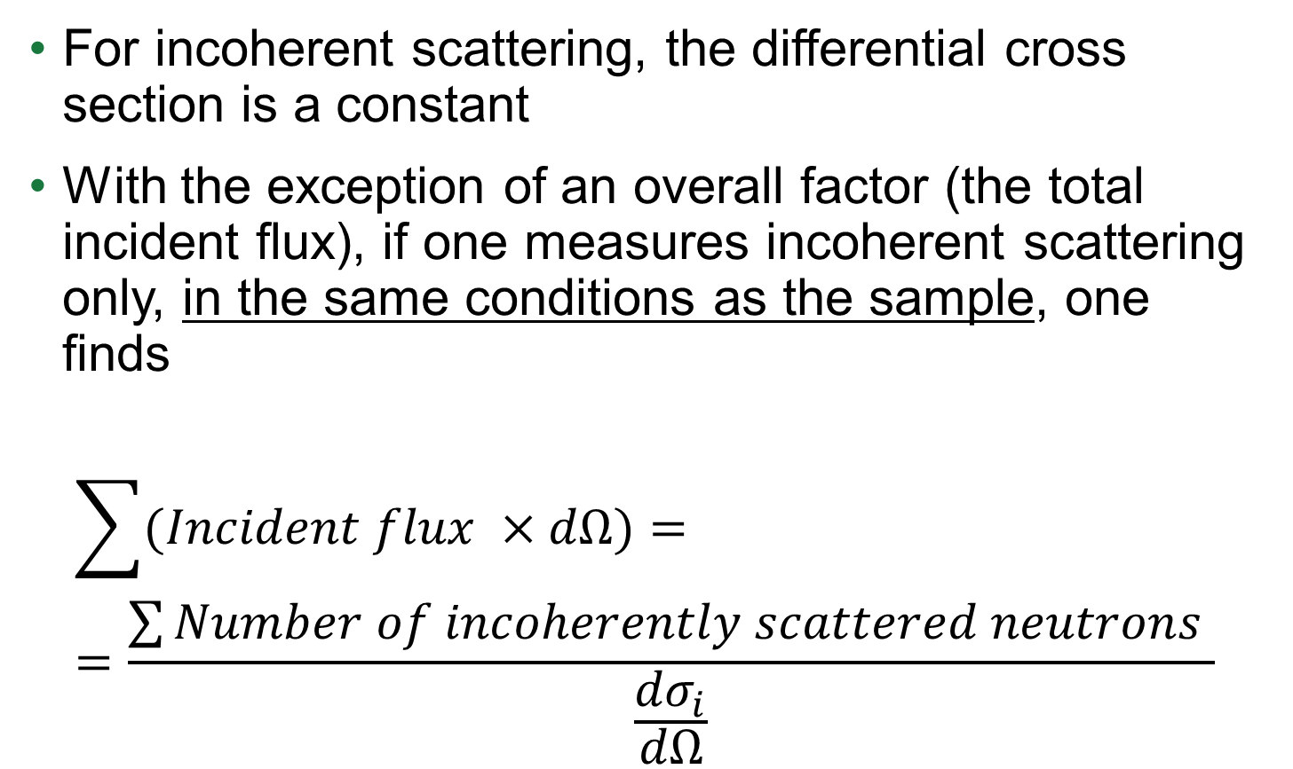
Using incoherent scattering (vanadium)
For incoherent scattering, the differential cross section is a constant
With the exception of an overall factor (the total incident flux), if one measures incoherent scattering only, in the same conditions as the sample, one finds
$$\sum{(Incident flux ×dΩ})==\frac{\sum{Number of incoherently scattered neutrons }}{\frac{{dσ}_{i}}{dΩ}}$$

Slide 15
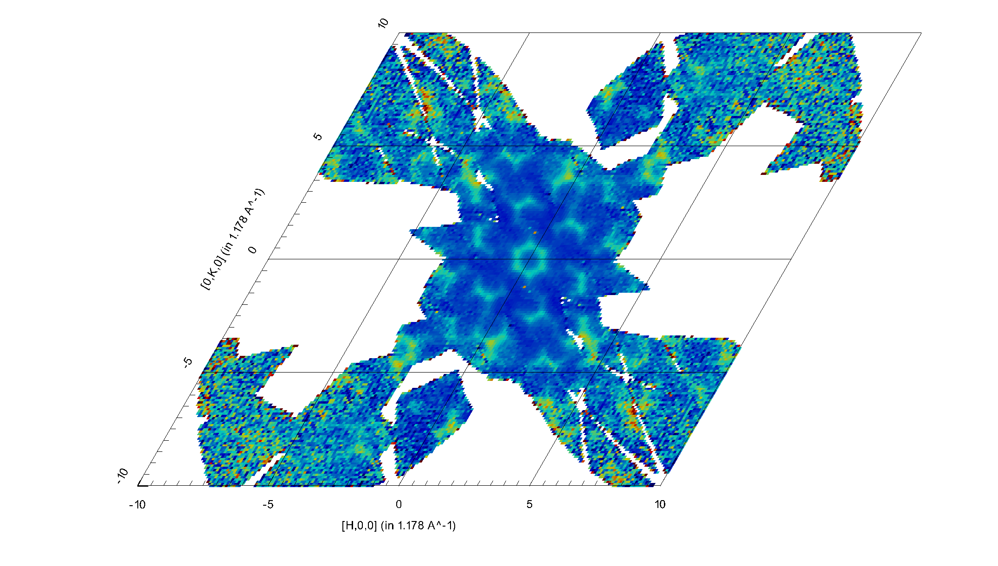
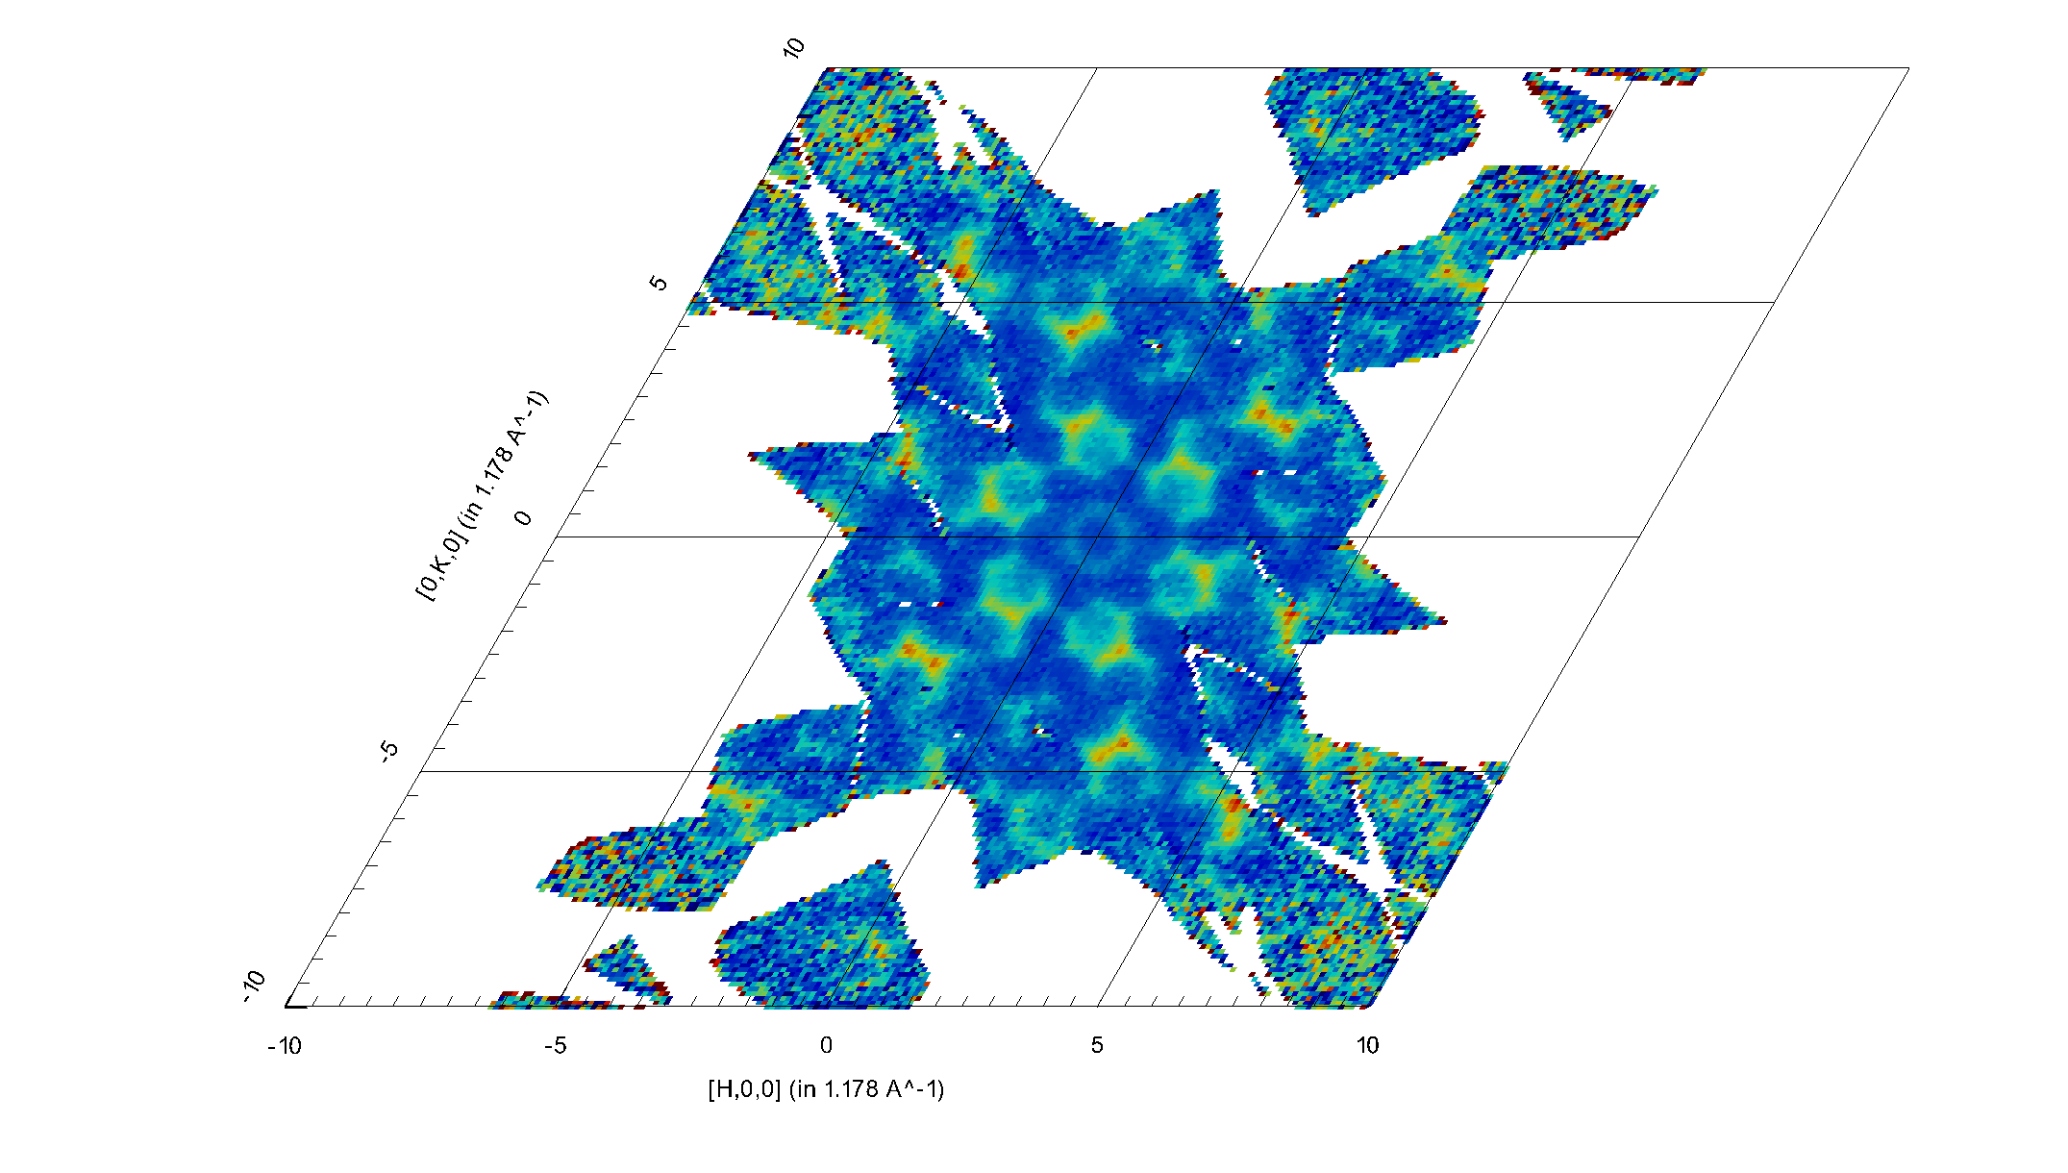
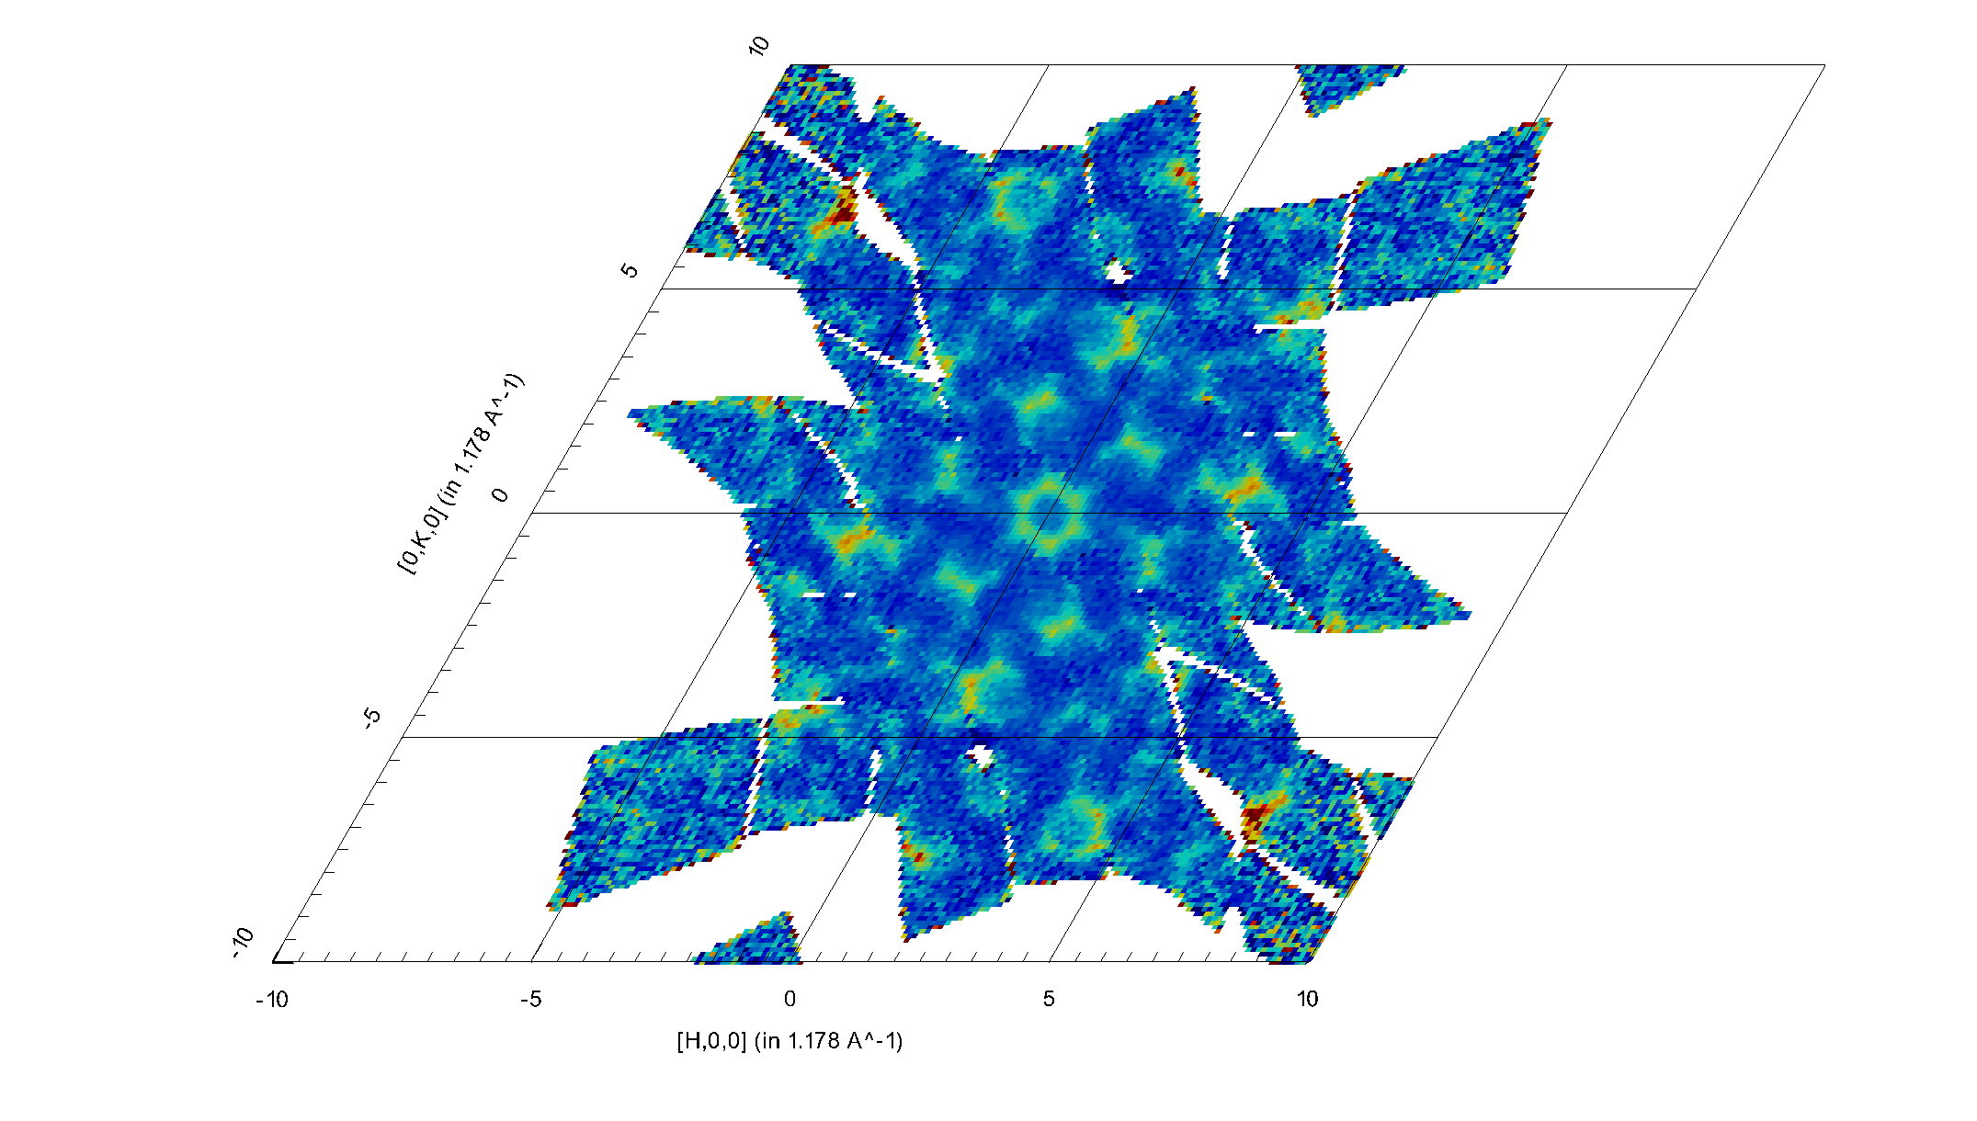
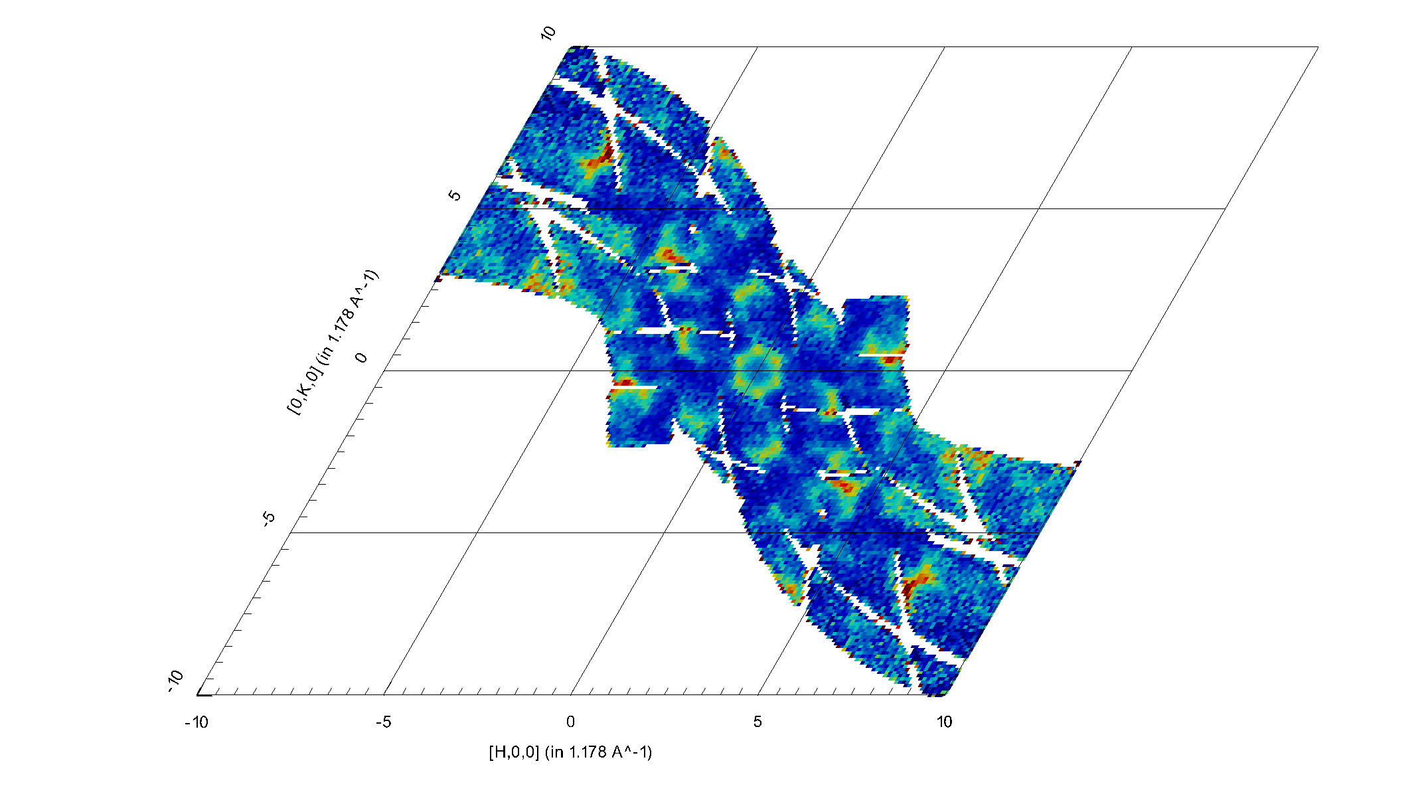
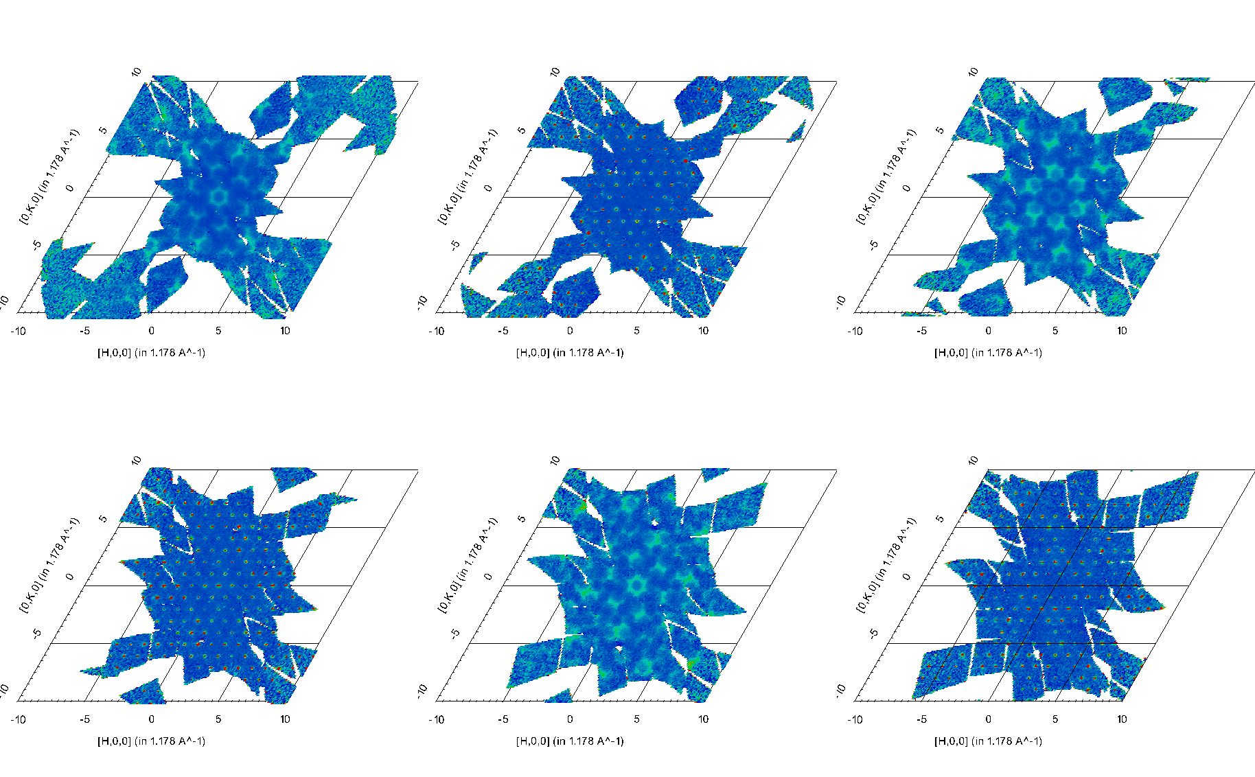
Example
[H,K,-2.5] [H,K,-3] [H,K,-3.5]
[H,K,-4] [H,K,-4.5] [H,K,-5]

Slide 16
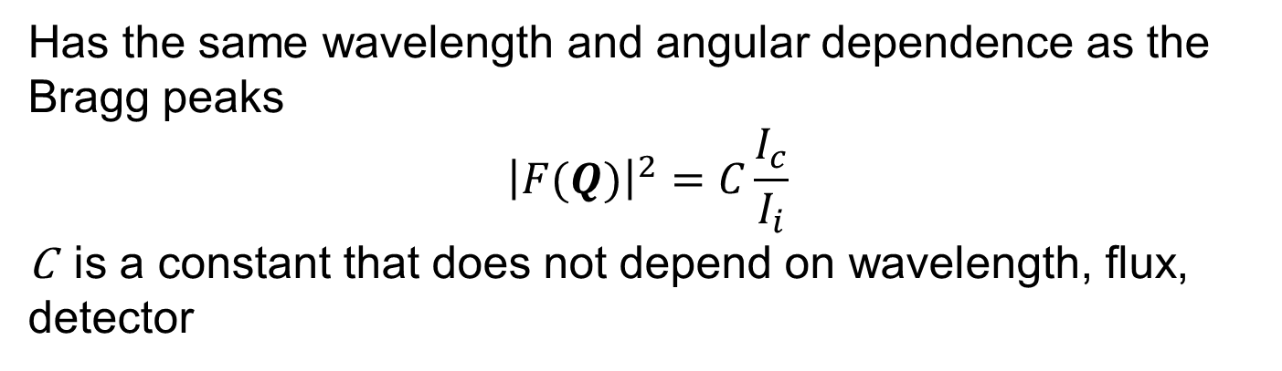
Lorentz and spectrum corrections (II)
Approximation of small volume
Has the same wavelength and angular dependence as the Bragg peaks
$${\left|F(Q)\right|}^{2}=C\frac{I_{c}}{I_{i}}$$
C is a constant that does not depend on wavelength, flux, detector

Slide 17
Procedure outline
Treat data as before, but no proton charge normalization, and without Lorentz/spectrum corrections
For each orientation/measurement create an equivalent incoherent scattering dataset
Copy the goniometer settings
Copy the UB
Multiply with data proton charge
Convert to MD
Bin all real data and incoherent normalization data on the same MD grid
Sum data, sum normalization, then divide

Slide 18
Memory and statistics problems
Keeping vanadium in events is very memory intensive (24GB per rotation)
Solution: switch to 3D histogram early (3GB – independent of number of rotations)
Low number of detectors contributing to each HKL box means low statistics
Solution: average all detector pixels in a bank (feasible only on histogram data)
Slow (3-4 hours to change the bin size for the whole dataset)
Solution: do something new

Slide 19
Next generation diffraction normalization
For TOF diffraction, the biggest problem is calculating the incident neutron flux that contribute to each MD box
For each detector trajectory in reciprocal space calculate the intersection with each MD box
Integrate vanadium scattering (proportional to incident, momentum dependent flux) between the momenta corresponding to those intersections

Slide 20
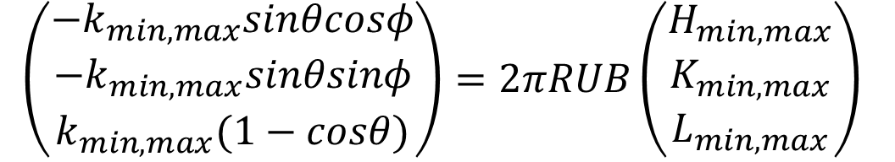
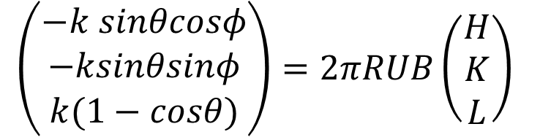
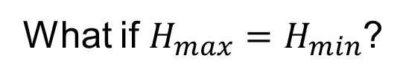
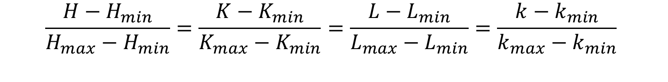
How to calculate intersections?
$$\left(\begin{aligned}−k sinθcosφ \\ −ksinθsinφ \\ k(1−cosθ)\end{aligned}\right)=2πRUB\left(\begin{aligned}H \\ K \\ L\end{aligned}\right)$$
Apply to minimum and maximum wavevectors
$$\left(\begin{aligned}−k_{min,max}sinθcosφ \\ −k_{min,max}sinθsinφ \\ k_{min,max}(1−cosθ)\end{aligned}\right)=2πRUB\left(\begin{aligned}H_{min,max} \\ K_{min,max} \\ L_{min,max}\end{aligned}\right)$$
$$\frac{H−H_{min}}{H_{max}−H_{min}}=\frac{K−K_{min}}{K_{max}−K_{min}}=\frac{L−L_{min}}{L_{max}−L_{min}}=\frac{k−k_{min}}{k_{max}−k_{min}}$$
What if $H_{max}=H_{min}$?

Slide 21
How to integrate flux?
We need to calculate the integrated flux between two wave vectors for every detector that has a trajectory passing through a particular MD box.
For better statistics, we can group detectors that have the same energy response.
To improve speed and memory – calculate the indefinite integral. The integral in the MD box is the difference between the values of the indefinite integral at the two intersections

Slide 22
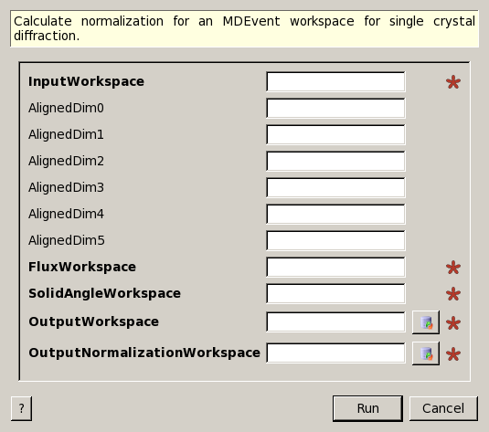
Mantid implementation
MDNormSCD
Input MDEvent workspace
Binning along different axes
A workspace containing flux
A workspace containing solid angle/efficiency
Output workspace contains data
Output normalization workspace is the statistical weight
Add output data, add normalizations, then divide

Slide 23
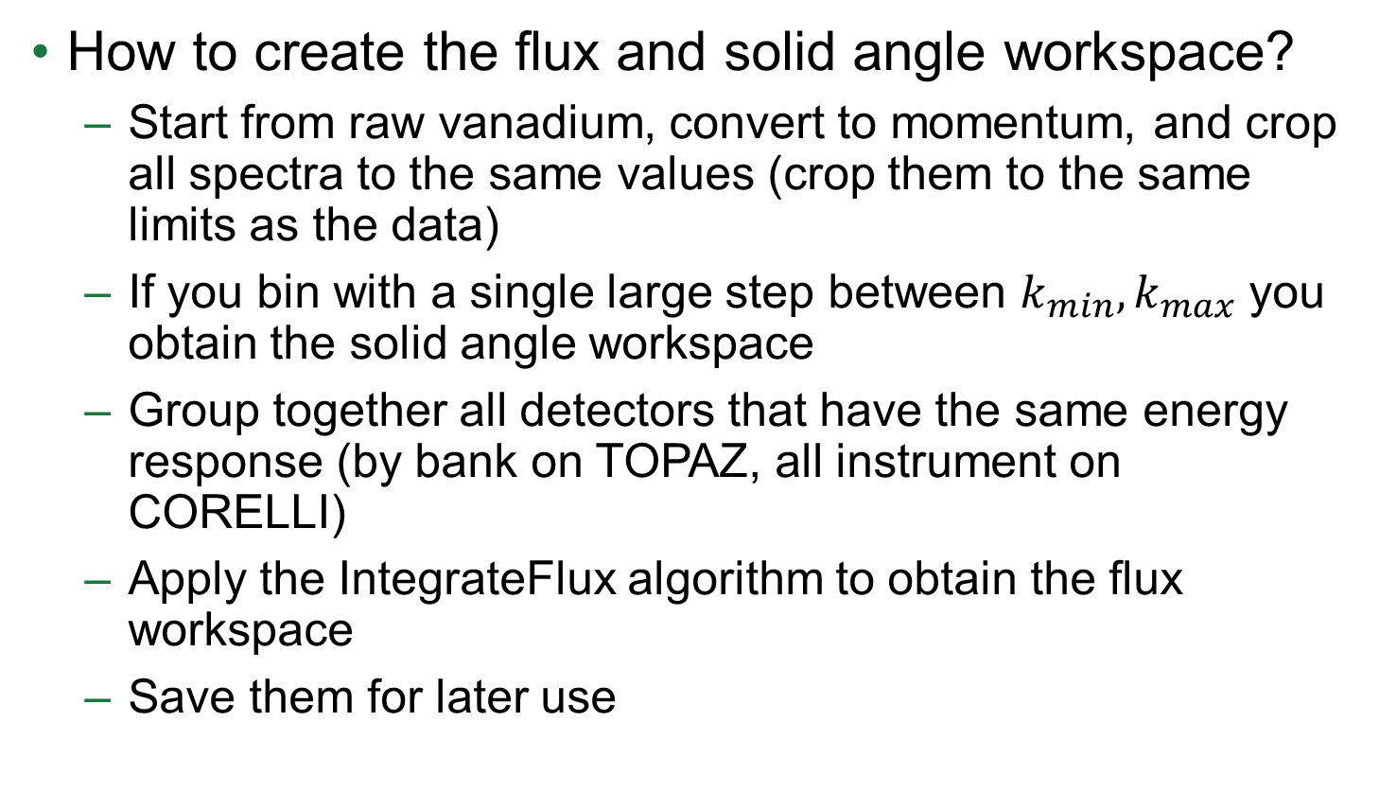
Mantid implementation
How to create the flux and solid angle workspace?
Start from raw vanadium, convert to momentum, and crop all spectra to the same values (crop them to the same limits as the data)
If you bin with a single large step between $k_{min},k_{max}$ you obtain the solid angle workspace
Group together all detectors that have the same energy response (by bank on TOPAZ, all instrument on CORELLI)
Apply the IntegrateFlux algorithm to obtain the flux workspace
Save them for later use

Slide 24
Mantid implementation
What is the performance of this procedure?
Speed – 10-20 seconds to calculate normalization for each orientation
Memory – solid angle and flux workspaces are on the order of 10-20 MB. If your MD event workspace for data fits in half of the memory of your computer, you can probably do it on your laptop
Reuse workspaces – processing vanadium is slow and memory intensive. Do it on analysis.sns.gov or on the instrument computers and save the results. Save the MD event workspaces of the data
If possible use autoreduction scripts to process your data, so all you need to do after that is normalize, add and divide

Slide 25
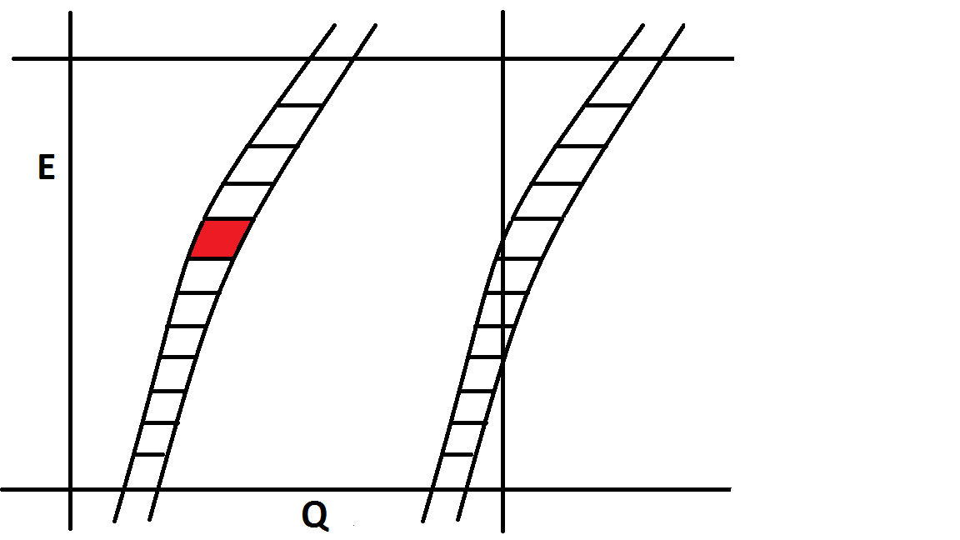
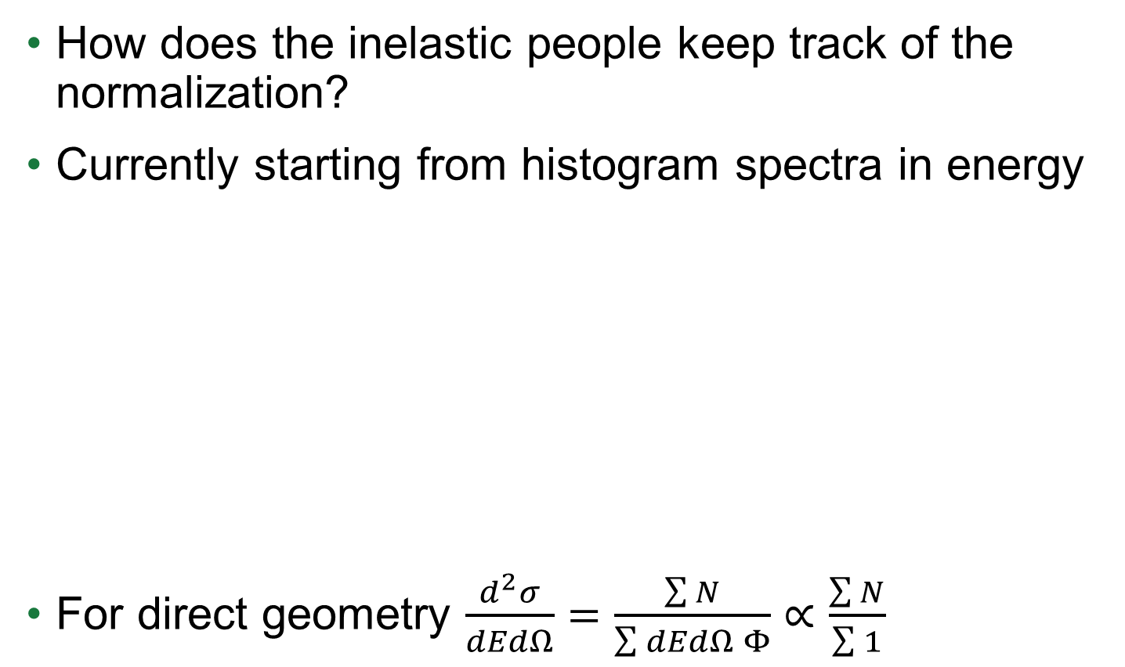
Single crystal inelastic data reduction
How does the inelastic people keep track of the normalization?
Currently starting from histogram spectra in energy
For direct geometry $\frac{d^{2}σ}{dEdΩ}=\frac{\sum{N}}{\sum{dEdΩ Φ}}∝\frac{\sum{N}}{\sum{1}}$

Slide 26
Problems with the current software
Assume all detectors have the same solid angle
Assume all configurations have the same flux
Relies on energy bins being small
Many (most) of those bins are empty. They are just used to see where measurements were performed (very memory intensive)

Slide 27

Next generation inelastic normalization
$$\frac{d^{2}σ}{dΩ dE}=\frac{\sum{Number of scattered neutrons}}{\sum{Incident flux ×dΩ×dE}}$$
dE is the length of a detector trajectory in a MD box along energy transfer
Trajectory is dependent on both incident and scattered momentum
For direct geometry the incident flux is just a number
For indirect geometry the incident flux calculation is similar to the diffraction case

Slide 28

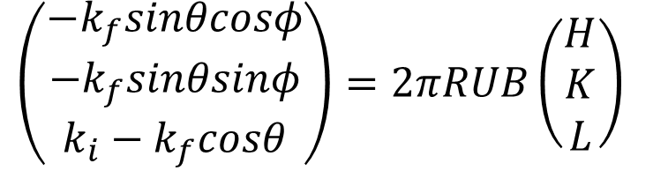
Calculating intersections
$$\left(\begin{aligned}−k_{f}sinθcosφ \\ −k_{f}sinθsinφ \\ k_{i}−k_{f}cosθ\end{aligned}\right)=2πRUB\left(\begin{aligned}H \\ K \\ L\end{aligned}\right)$$
For direct geometry incident momentum is fixed – trajectories are linear in scattered momentum
For indirect geometry final momentum is fixed
$$\frac{H−H_{min}}{H_{max}−H_{min}}=\frac{K−K_{min}}{K_{max}−K_{min}}=\frac{L−L_{min}}{L_{max}−L_{min}}=\frac{k_{i,f}−k_{i,f min}}{k_{i,f max}−k_{i,fmin}}$$
$$=\frac{\sqrt{E_{i,f}}−\sqrt{E_{i,fmin}}}{\sqrt{E_{i,fmax}}−\sqrt{E_{i,fmin}}}$$

Slide 29
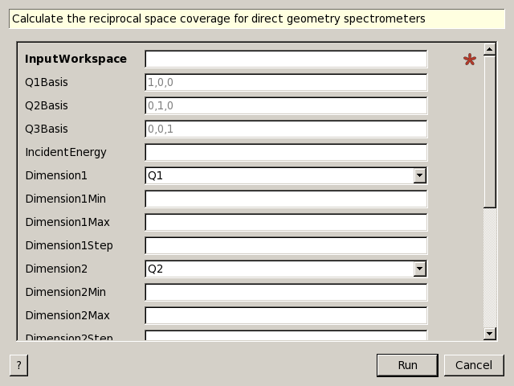
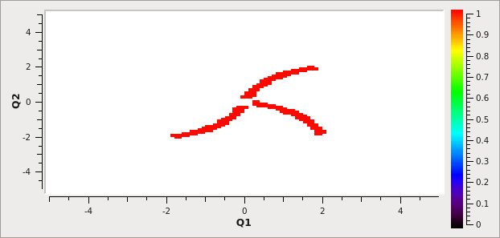
Use intersections for planning tools
Future planning tools based on CalculateCoverageDGS
Input workspace contains instrument description, Ei, goniometer, and UB matrix
Choose basis (HH0, -HH0, 00L)
Select minimum, maximum, and step
Outputs 1 where trajectories intersect boxes
Add multiple orientations or geometries with OrMD

Slide 30
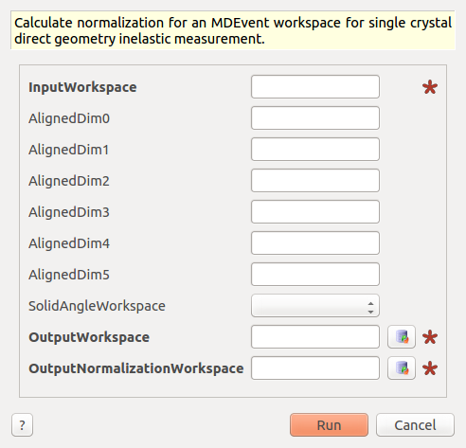
Mantid implementation
MDNormDirectSC
Same as before, use DGS reduction
No proton charge normalization
See if keeping events yield smaller files
Calculate normalization for each run
Add together binned data, binned normalization, then divide
This algorithm is experimental – please provide feedback
Allows for correct accounting of multiple runs, with different proton charge, different geometry, and, with very little work could account for different incident energies (multiply with absolute vanadium factor)

Slide 31
Future Mantid plans
Integration methods for “normalized data”
Implement indirect geometry normalization
Implement inelastic powder normalization
Implement non axis-aligned bins
Symmetrization
Data processing for reactor based instruments

Slide 32
What is the errorbar for 0?
The question depends on HOW we measured that 0
For raw data the errorbar is 0
For normalized data the erorbar is 1/normalization

Slide 33
REMEMBER!
Don’t treat normalized data as if unnormalized:
Add data together, add normalizations together, and then divide.
If you need different binning, go back to the original data.
Instrument scientists: be aware of how the measurement is performed.
Explain the physics to the software scientists, not just give formulas to implement
It is time to revisit many of the approximations and procedures for data analysis

Slide 34
Acknowledgements
Martyn Gigg, Roman Tolchenov – improve speed
Michael Reuter, Owen Arnold – feedback on the design, nice pictures and movies
Vickie Lynch – help with the initial normalization
Ross Whitfield – testing the new normalization on other datasets
Diffraction data provided by Tara Michels-Clark/ Christina Hoffmann
ORNL and ISIS instrument scientists – feedback
Other group members – feedback
Research conducted at ORNL's Spallation Neutron Source was sponsored by the Scientific User Facilities Division, Office of Basic Energy Sciences, US Department of Energy.

